Slide 1
CS 31007 Autumn 2020 COMPUTER ORGANIZATION AND ARCHITECTURE
Instructors
Rajat Subhra Chakraborty
Bhargab B. Bhattacharya
Week 6: October 05, 2020
Indian Institute of Technology Kharagpur
Computer Science and Engineering
Notes:
Good Morning!
The title of today’s talk is “On some Planar Partitioning Problems”.

Slide 2
So far covered in computer arithmetic…
Number Systems and Overflow
Ripple-Carry Adder (RCA)
Carry-Lookahead Adder (CLA)
Hybrid Adder, CLT
Carry-Select Adder (CSA)
Brent-Kung’s Parallel Prefix Adder (PPA)
Carry-Save Adders (for adding multiple operands)
Today: Integer Multiplication
Notes:
Good Morning!
The title of today’s talk is “On some Planar Partitioning Problems”.

Slide 3

Integer Multiplication

Slide 4
Multiplication
 |  |  |  | 1 | 0 | 0 | 0
 |  |  | × | 0 | 1 | 0 | 1
 |  |  |  | 1 | 0 | 0 | 0
 |  |  | 0 | 0 | 0 | 0
 |  | 1 | 0 | 0 | 0
 | 0 | 0 | 0 | 0
 | 0 | 1 | 0 | 1 | 0 | 0 | 0
- 8
+ 8
2’s compl.
+5
+ 5
Multiplicand
Multiplier
Partial products
Final sum
Base 10: 8 × 5 = 40
=> 32 + 0 + 8 = 40
How wide is the result?
=> log(n × m) = log n + log m
=> 32-bit × 32-bit = 64-bit result
unsigned
Can you notice the need for Carry-Save Addition? We need to add multiple numbers!

Slide 5
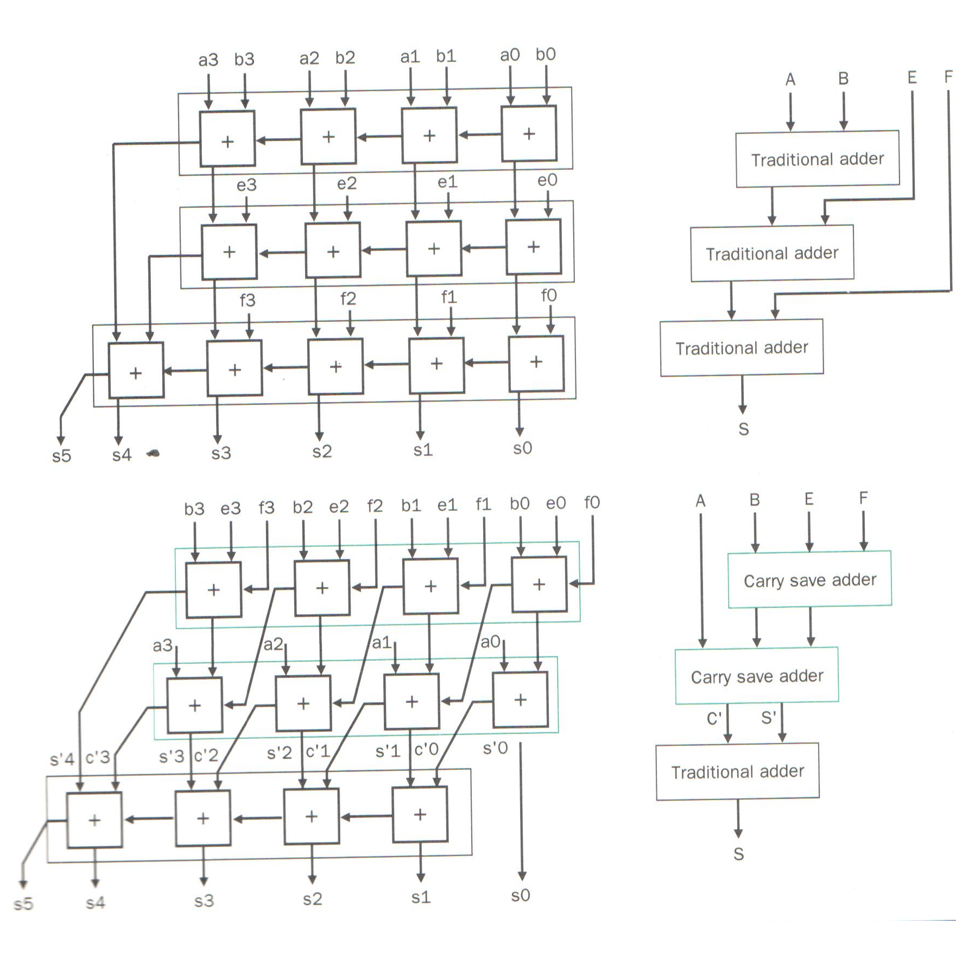
CARRY-SAVE ADDER (addition of multiple operands)
Add four 4-bit integers, A, B, E, F

Slide 6
Unsigned Multiplication
A_{i} and B_{i} are all 0 or 1

Slide 7
Multiplication
More complicated than addition
Accomplished via
Array multipliers
shifting and repeated addition
More time and more area 0101 0010 (multiplicand) x 0110 1101 (multiplier)
Negative numbers: convert and multiply
Use other better techniques like Booth’s encoding

Slide 9
Array Multiplier Using Carry-Save Adders
Carry-Save Adder

Slide 10
Array Multiplier Using Carry-Save Adders (CSA
CLT

Slide 11
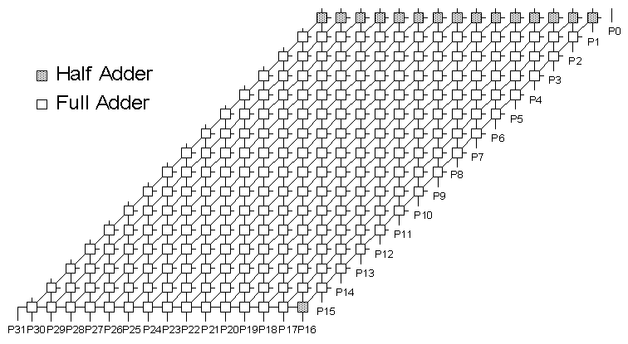
16-bit Array Multiplier
[Courtesy: J. Hayes, Univ. of Michigan]
Conceptually straightforward
Fairly expensive hardware, integer multiplies relatively rare
Mostly used in array address calc: replace with shifts

Slide 12
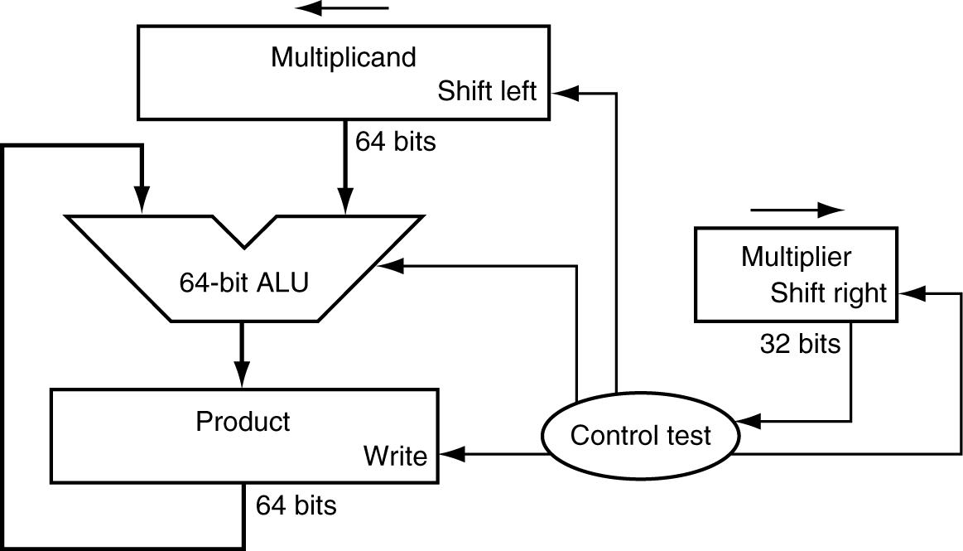
Multiplication (Shift and Repeated Additions)
§3.3 Multiplication
Mimic the multiplication process in hardware
multiplicand
1000
× 1001
1000
0000
0000
1000
1001000
multiplier
product
Length of product is the sum of operand lengths

Slide 13
Explanations
Multiplicand register is kept 64-bit wide because 32-bit multiplicand will be shifted 32 times to the left
Requires a 64-bit ALU
Product register must be 64-bit wide to accommodate the result
Contents of multiplier register is shifted 32 times to the right so that each bit successively appears as the least significant bit (LSB) to be checked by the controller

Slide 14
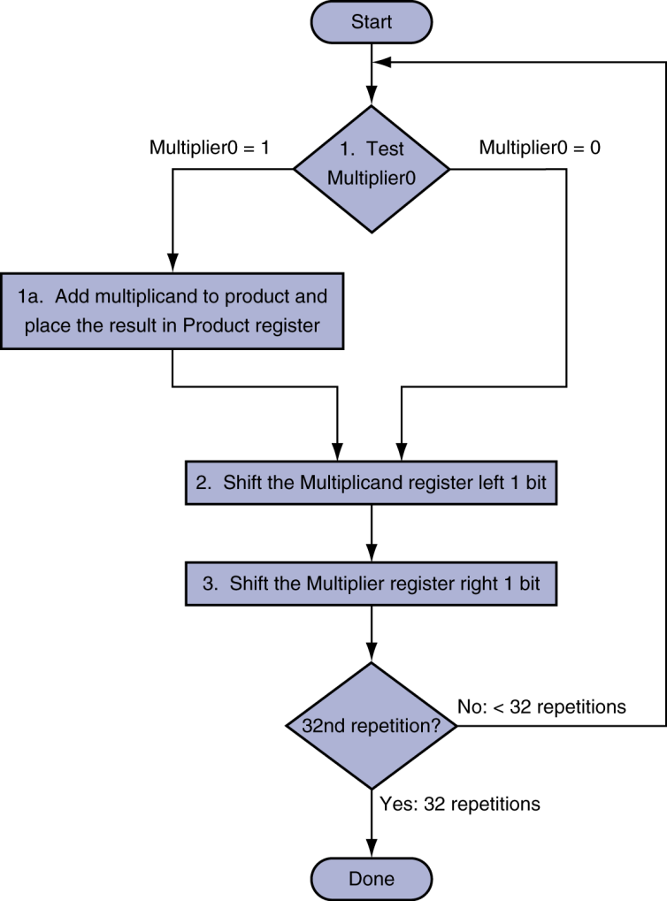
Multiplication Hardware
Initially 0

Slide 15
A Little Optimized Version

Slide 16
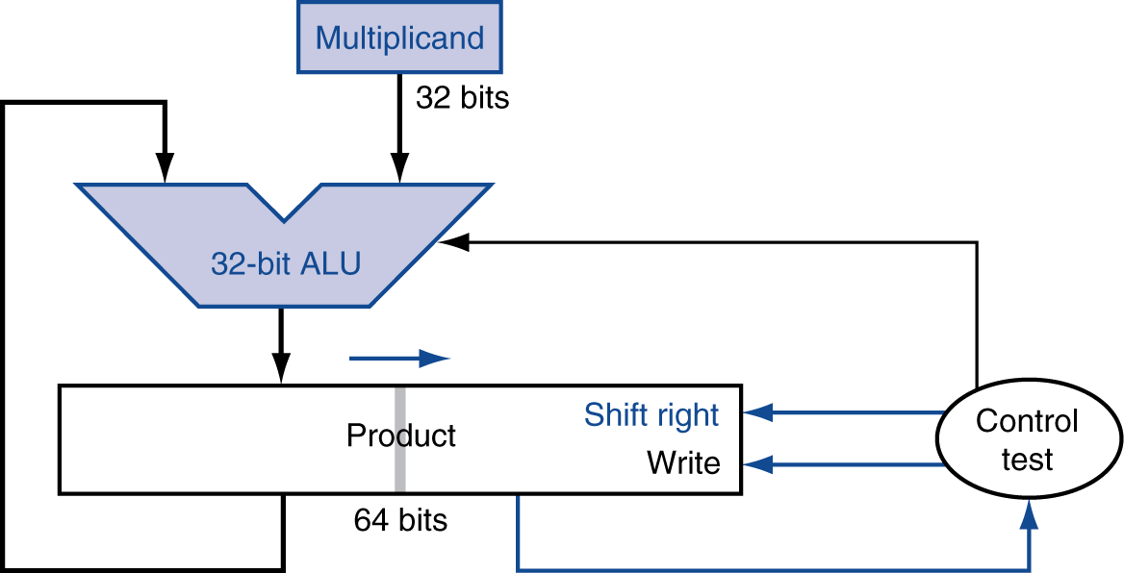
Further Optimized Version of Multiplier
Perform steps in parallel: add/shift
Multiplier
(32-bits)
One cycle per partial-product addition

Slide 17
Optimized Multiplication: Implementation

Slide 18
Multiplication Example
0010 × 0110 = ? 0010 (+ 2, multiplicand); 0110 (+ 6, multiplier)
logical shift
+12

Slide 19
Signed Multiplication
Recall
For p = a × b, if either a < 0 or b < 0, then p < 0
If (a < 0 and b < 0) or (a > 0 and b > 0) then p > 0
Hence sign(p) = sign(a) ⊕ sign(b)
Hence
Convert multiplier and multiplicand to positive number each
Multiply two positive numbers
Compute sign, convert product accordingly

Slide 20
Booth’s Encoding (valid for signed multiplication as well)
Recall old trick
When multiplying by 9:
Multiply by 10 (easy, just shift digits left)
Subtract once
e.g.,
123454 × 9 = 123454 × (10 – 1) = 1234540 – 123454
Converts addition of six partial products to one shift and one subtraction
Booth’s algorithm applies the same principle
in binary we have just ‘1’ and ‘0’

Slide 21
Booth’s Encoding
Multiply x by 0111
x (multiplicand); 0111 (multiplier) => x ×7
Search for a run of ‘1’ bits in the multiplier
e.g. ‘0111’ has a run of 3 ‘1’ bits in the middle
Multiplying by ‘0111’ (7 in decimal) is equivalent to multiplying by 8 and subtracting once, since
x ×7 = x ×(8 – 1) = 8x – x =>(shift-left x, three times) - x
Hence, iterate right to left and look for “runs of 1”:
Subtract multiplicand from product at first ‘1’
Shift multiplicand by 3-bits on left and add to the partial product after the last ‘1’
Do nothing for the consecutive 1-bits/in the middle, or for 0-runs (actually, we keep on shifting the product register)

Slide 22
Booth’s Encoding for Multiplier
middle of 1-run (11)
beginning of 1-run (10)
0 1 0 0 0 0 1 1 1 1 0 0
0-run (00)
end of 1-run (01)

Slide 23
Booth’s Algorithm
Current bit | Bit to right | Explanation | Example (multiplier) | Operation
1 | 0 | Begins run of ‘1’ | 00001111000 | Subtract/shift
1 | 1 | Middle of run of ‘1’ | 00001111000 | Nothing/shift
0 | 1 | End of a run of ‘1’ | 00001111000 | Add/shift
0 | 0 | Middle of a run of ‘0’ | 00001111000 | Nothing/shift

Slide 24
Booth’s Encoding
Really just a new way to encode numbers
Normally positionally weighted as 2^{n}
With Booth, each position has a sign bit
Can be extended to multiple bits
0 | 1 | 1 | 0 | Binary
+1 | 0 | -1 | 0 | Booth’s encoding

Slide 25
Booth’s algorithm: Example
0010 × 1101 = ? 0010 (+ 2, multiplicand); 1101 (- 3, multiplier)
arithmetic shift
op performed in the left half
initialization
start of
1-run
end of
1-run
-6

Slide 26
MIPS Multiplication
Two 32-bit registers for product
HI: most-significant 32 bits
LO: least-significant 32-bits
Instructions
mult rs, rt / multu rs, rt
64-bit product in HI/LO
mfhi rd / mflo rd
Move from HI/LO to rd
Can test HI value to see if product overflows 32 bits
mul rd, rs, rt
Least-significant 32 bits of product –> rd

Slide 27
CS 31007 Autumn 2020 COMPUTER ORGANIZATION AND ARCHITECTURE
Instructors
Rajat Subhra Chakraborty
Bhargab B. Bhattacharya
Week 6: October 06, 2020
Indian Institute of Technology Kharagpur
Computer Science and Engineering
Notes:
Good Morning!
The title of today’s talk is “On some Planar Partitioning Problems”.

Slide 28
So far covered in computer arithmetic…
Integer Number Systems and Overflow
Ripple-Carry Adder (RCA)
Carry-Lookahead Adder (CLA)
Hybrid Adder, CLT
Carry-Select Adder (CSA)
Brent-Kung’s Parallel Prefix Adder (PPA)
Carry-Save Adders (for adding multiple operands)
Integer Multiplication
Today
Integer Division
Floating-Point Arithmetic and Hardware
Notes:
Good Morning!
The title of today’s talk is “On some Planar Partitioning Problems”.

Slide 29
Division
Implemented by successive subtractions
Result must verify the equality
Dividend = (Multiplier × Quotient) + Remainder

Slide 30
Decimal division
 | 303
7 | 2126
 | -210
 | 26 -21 5
What are the rules?
Repeatedly try to subtract a multiple of divisor from dividend
Record multiple (or zero)
At each step, repeat with a lower power of ten
Stop when remainder is smaller than divisor

Slide 31
Integer Division in Binary
§3.4 Division
Check for 0 divisor
Long division approach
If divisor ≤ dividend bits
1 bit in quotient, subtract
Otherwise
0 bit in quotient, bring down next dividend bit
Restoring division
Do the subtract, and if remainder goes < 0, add divisor back
Signed division
Divide using absolute values
Adjust sign of quotient and remainder as required
quotient
dividend
1001
1000 1001010
-1000
10
101
1010
-1000
10
divisor
remainder
n-bit operands yield n-bit quotient and remainder

Slide 32
Integer Division
 |  |  |  |  |  |  |  | 1 | 0 | 0 | 1 | Quotient
Divisor | 1 | 0 | 0 | 0 | 1 | 0 | 0 | 1 | 0 | 1 | 0 | Dividend
 |  |  |  | - | 1 | 0 | 0 | 0
 |  |  |  |  |  |  |  | 1 | 0
 |  |  |  |  |  |  |  | 1 | 0 | 1
 |  |  |  |  |  |  |  | 1 | 0 | 1 | 0
 |  |  |  |  |  |  | - | 1 | 0 | 0 | 0
 |  |  |  |  |  |  |  |  |  | 1 | 0 | Remainder

Slide 33
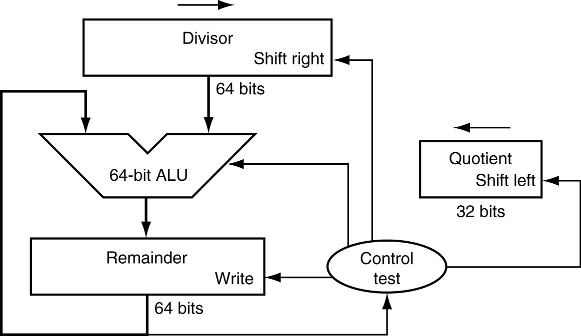
Division Hardware
Initially divisor in left half
Initially dividend

Slide 34
Restoring Division

Slide 35
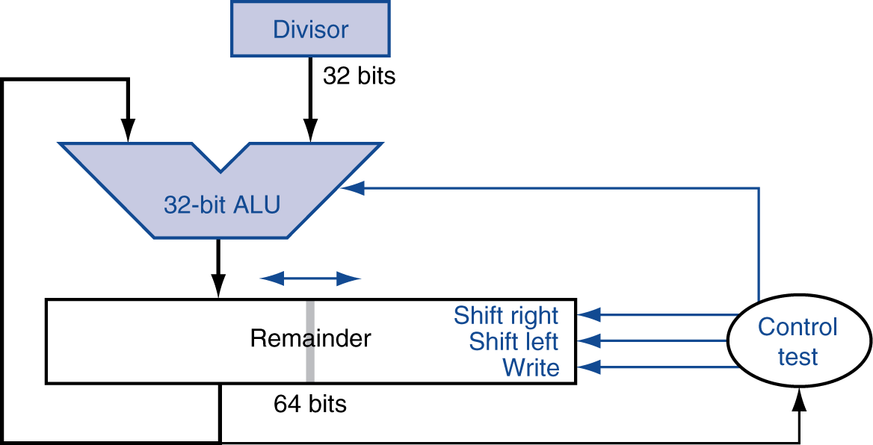
Optimized Divider
One cycle per partial-remainder subtraction
Looks a lot like a multiplier!
Same hardware can be used for both

Slide 36
MIPS Division
Use HI/LO registers for result
HI: 32-bit remainder
LO: 32-bit quotient
Instructions
div rs, rt / divu rs, rt
No overflow or divide-by-0 checking
Software must perform checks if required
Use mfhi, mflo to access result

Slide 37
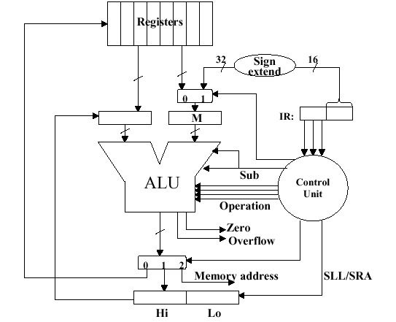
MIPS Architecture for Integer Arithmetic: Multiplication and Division

Slide 38
Floating Point: Format, Arithmetic, and Hardware Implementation
software
instruction set
hardware

Slide 39
The IEEE Floating-Point Standard

Slide 40
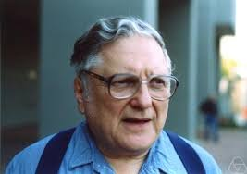
A computation error observed by a UG student led to the ACM Turing Award later ….
1953: Willian Kahan, a UG student of Math at the University of Toronto was simulating numerically the dynamics of the wing controller of an aircraft during take-off and landing
Observed certain unexpected results due to errors in computation
=> concept of floating-point (FP) arithmetic
=> principal architect behind IEEE 754 FP standard (1985)
=> Kahan honored with ACM Turing Award (1989)
William Kahan (1933 - )

Slide 41
Floating-Point Representation
Used to represent real numbers
Defined by IEEE 754 Standard
--- Kahan (1985)
Developed in response to divergence of representations
Portability issues for scientific code
Now almost universally adopted
Two representations
Single precision (32-bit)
Double precision (64-bit)
Infamous Intel Pentium Bug (1994) =>FDIV => loss of $300 Million

Slide 42
Floating Point
§3.5 Floating Point
Representation for non-integral numbers
Including very small and very large numbers
Like scientific notation
–2.34 × 10⁵⁶
+0.002 × 10^{–4}
+987.02 × 10⁹
In binary
±1.xxxxxxx₂ × 2^{yyyy}
Types float and double in C
normalized
not normalized

Slide 43
IEEE Floating-Point Format
Fraction
≡Mantissa
≡ Significand
single: 8 bits double: 11 bits
single: 23 bits double: 52 bits
S
Exponent
Mantissa (M)
$$N=(−1)^{S}×(1.M)×2^{(Exponent−Bias)}$$
S: sign bit (0 ⇒ non-negative, 1 ⇒ negative)
Normalize significand: 1.0 ≤ |significand| < 2.0
Always has a leading pre-binary-point 1 bit, so no need to represent it explicitly (hidden bit)
Normalized Significand is Mantissa with the “1.” restored
Exponent: excess representation: actual exponent + Bias
Ensures exponent is unsigned
Single: Bias = 127; Double: Bias = 1023
Trade-off between range (E) and precision (M)

Slide 44
IEEE 754 Single-Precision Floating-Point
Representation of floating point numbers in IEEE 754 standard:
single precision
1
8
23
sign
S
E
M
FP-exponent E:
excess 127 binary coding
mantissa:
sign + magnitude, normalized
binary significand w/ hidden
integer bit: 1.M
Actual exponent is e = E – 127
Floating-point exponent E = e + 127
FP-exponent (E) Actual exponent e
00000000 (0) Special use
00000001 (1) - 126
00000010 (2) - 125
…………. …….
01111111 (127) 0
…………. …….
11111110 (254) + 127
11111111 (255) Special use

Slide 45
IEEE 754 floating-point standard
Leading “1” bit of significand is implicit
Exponent is “biased” to make comparison easier
all 0s is smallest exponent; all 1s is largest
bias of 127 for single precision and 1023 for double precision
summary: (–1)^{sign} × (1+significand) × 2^{exponent – bias}
Example 1 (Encoding):
For a given decimal number, construct its FP-representation
decimal: - 0.75
→ binary: - 0.11 = - 1.1 x 2⁻¹ (normalized)
→ Floating-point exponent = - 1 +127 = 126 = 01111110
IEEE single precision:
- 0.75 = 1 01111110 10000000000000000000000

Slide 46
Decoding a floating-point number
S
E
M
Sign indicated by first bit S → (-1)^{S}
Subtract 127 from biased exponent E to obtain the actual exponent e = E - 127
Number in binary = (-1)^{S} 1.M × 2e

Slide 47
Example 1
0
0111 1111
0000 0000 0000 0000 0000 000
Sign bit is zero: Number is positive
Biased exponent E = 01111111 |₂ = 127;
Actual exponent e = E – 127 = 0 → 2⁰
Mantissa is all-zero → 1.0 (restored the hidden bit)
The number = + 1.0 × 2⁰ |₂ =1.0|₁₀

Slide 48
Example 2
0
1000 0000
1000 0000 0000 0000 0000 000
Sign bit is zero: Number is positive
Biased exponent E = 1000 0000 |₂ = 128;
Actual exponent e = E – 127 = 1 → 2¹
Significand → 1.1 (restored the hidden bit)
The number = + 1.1 × 2¹ |₂ = + 11 |₂ = + 3.0|₁₀

Slide 49
Example 3
1
0111 1110
11000000000000000000000000000
Sign bit is one: Number is negative
Biased exponent E = 0111 1110 |₂ = 126;
Actual exponent e = E – 127 = - 1 → 2⁻¹
Significand → 1.11 (restored the hidden bit)
The number = - 1.11 × 2⁻¹ |₂ = - 0.111 |₂ = -0.875|₁₀

Slide 50
Example 4
What number is represented by the single-precision float
1 10000001 01000………00
S = 1
Mantissa = 01000…00₂
FP-Exponent = 10000001₂ = 129
N = (–1)¹ × (1 + .01₂) × 2^{(129 – 127)}
= (–1) × 1.01 × 2²
= –101|₂ = – 5.0|₁₀

Slide 51
Example 2 (Encoding)
Represent –2 in FP-format
Convert to binary: 10
Normalize: 1.0×2¹
Sign bit is 1
FP-exponent is 127 + 1 = 128 = 10000000_{two}
Mantissa is 00…0
1
1000 0000
0000 0000 0000 0000 0000 000

Slide 52
How do I represent zero then ? → 1. M × 2^{E -127}
0/1
0000 0000
0000 0000 0000 0000 0000 000
FP-exponent (E) Actual exponent e
00000000 (0) Special use
00000001 (1) - 126
00000010 (2) - 125
…………. …….
01111111 (127) 0
…………. …….
11111110 (254) + 127
11111111 (255) Special use
* Any non-zero number that is smaller than the smallest normalized FP-number is a denormal number (consider magnitude only)

Slide 53
Single-Precision Range
Exponents 00000000 and 11111111 reserved
Smallest value
Exponent: 00000001 ⇒ actual exponent = 1 – 127 = –126
Mantissa: 000…00 ⇒ normalized significand = 1.0
±1.0 × 2^{–126} ≈ ±1.2 × 10^{–38}
Largest value
exponent: 11111110 ⇒ actual exponent = 254 – 127 = +127
Mantissa: 111…11 ⇒ normalized significand ≈ 2.0
±2.0 × 2⁺¹²⁷ ≈ ±3.4 × 10⁺³⁸

Slide 54
Double-Precision Range
Exponents 0000…00 and 1111…11 reserved
Smallest value
Exponent: 00000000001 ⇒ actual exponent = 1 – 1023 = –1022
Mantissa : 000…00 ⇒ norm. significand = 1.0
±1.0 × 2^{–1022} ≈ ±2.2 × 10^{–308}
Largest value
Exponent: 11111111110 ⇒ actual exponent = 2046 – 1023 = +1023
Mantissa: 111…11 ⇒ norm significand ≈ 2.0
±2.0 × 2⁺¹⁰²³ ≈ ±1.8 × 10⁺³⁰⁸

Slide 55
Floating-Point Precision
Relative precision
all mantissa-bits are significant
Single: approx 2^{–23}
Equivalent to 23 × log₁₀2 ≈ 23 × 0.3 ≈ 6 decimal digits of precision
Double: approx 2^{–52}
Equivalent to 52 × log₁₀2 ≈ 52 × 0.3 ≈ 16 decimal digits of precision

Slide 56
Single-Precision Normalized Range
Exponents 00000000 and 11111111 reserved
Smallest value
±1.0 × 2^{–126} ≈ ±1.2 × 10^{–38}
Largest value
= ±(2.0 – 2⁻²³) × 2⁺¹²⁷ ≈ ±3.4 × 10⁺³⁸
0/1
0000 0001
0000 0000 0000 0000 0000 000
0/1
1111 1110
1111 1111 1111 1111 1111 111
-1.0 × 2^{–126}
+1.0 × 2^{–126}
≈ -2.0 × 2⁺¹²⁷
≈ +2.0 × 2⁺¹²⁷
representable normalized -ve FP-numbers
-ve
under-flow
+ve
under-flow
representable normalized +ve FP-numbers
-ve overflow
+ve-overflow
0
real line

Slide 57
Single-Precision FP-Denormal Numbers
Exponents 00000000 and 11111111 reserved
Smallest value (normalized)
±1.0 × 2^{–126} ≈ ±1.2 × 10^{–38}
Denormal numbers (gradual underflow)
= ± 0.M × 2⁻¹²⁶ {min: ± 2⁻²³ × 2⁻¹²⁶; max: ± (1-2⁻²³ ) × 2⁻¹²⁶}
0/1
0000 0001
0000 0000 0000 0000 0000 000
0/1
0000 0000
M ≠ 0
≈ -2.0 × 2⁺¹²⁷
-1.0 × 2^{–126}
+1.0 × 2^{–126}
≈ +2.0 × 2⁺¹²⁷
representable normalized -ve FP-numbers
representable normalized +ve FP-numbers
under-flow
under-flow
overflow
overflow
0
real line

Slide 58

Denormal FP-Numbers
Exponent = 000...0 ⇒ hidden bit is 0
N$=(−1)^{S}×(0.Mantissa)×2^{− 126}$
Smaller than normalized numbers
allow for gradual underflow, with diminishing precision
Denormal with mantissa = 000...0
→ +0, -0

Slide 59
Infinities and NaNs
Exponent = 111...1, Mantissa= 000...0
± Infinity
Can be used in subsequent calculations, avoiding need for overflow check
Exponent = 111...1, Mantissa ≠ 000...0
Not-a-Number (NaN)
Indicates illegal or undefined result
e.g., 0.0 / 0.0, √-3
Can be used in subsequent calculations

Slide 60
Floating Point Complexities
Operations are somewhat more complicated
In addition to overflow, we may have “underflow”
Accuracy can be a big problem
IEEE 754 keeps three extra bits, guard, round, and sticky
several rounding modes
Non-zero number divide-by-zero yields “infinity” → overflow
Non-zero number divide-by-infinity yields → underflow
zero divide-by-zero yields “not a number (NaN)”
Implementing the standard can be tricky
Not using the standard can be even worse
Remember the 1994 Pentium FDIV bug; write-off cost US$ 300 M

Slide 61
Floating-Point Addition
Consider a 4-digit decimal example
99.99 + 0.1610
1. Align decimal points
9.999 × 10¹ + 0.016 × 10¹
2. Add significands
9.999 × 10¹ + 0.016 × 10¹ = 10.015 × 10¹
3. Normalize result & check for over/underflow
1.0015 × 10²
4. Round and renormalize if necessary
1.002 × 10²

Slide 62
Floating-Point Addition
Alignment
The proper digits have to be added
Addition of significands
Normalisation of the result
Rounding
Example in decimal system
precision 4 digits
What is 9.999 • 10¹ + 1.610 • 10⁻¹ ?
Result: 1.002 • 10²

Slide 63
FP-Adder Hardware
Much more complex than integer adder
Doing it in one clock cycle would take too long
Much longer than integer operations
Slower clock would penalize all instructions
FP adder usually takes several cycles
Can be pipelined

Slide 64
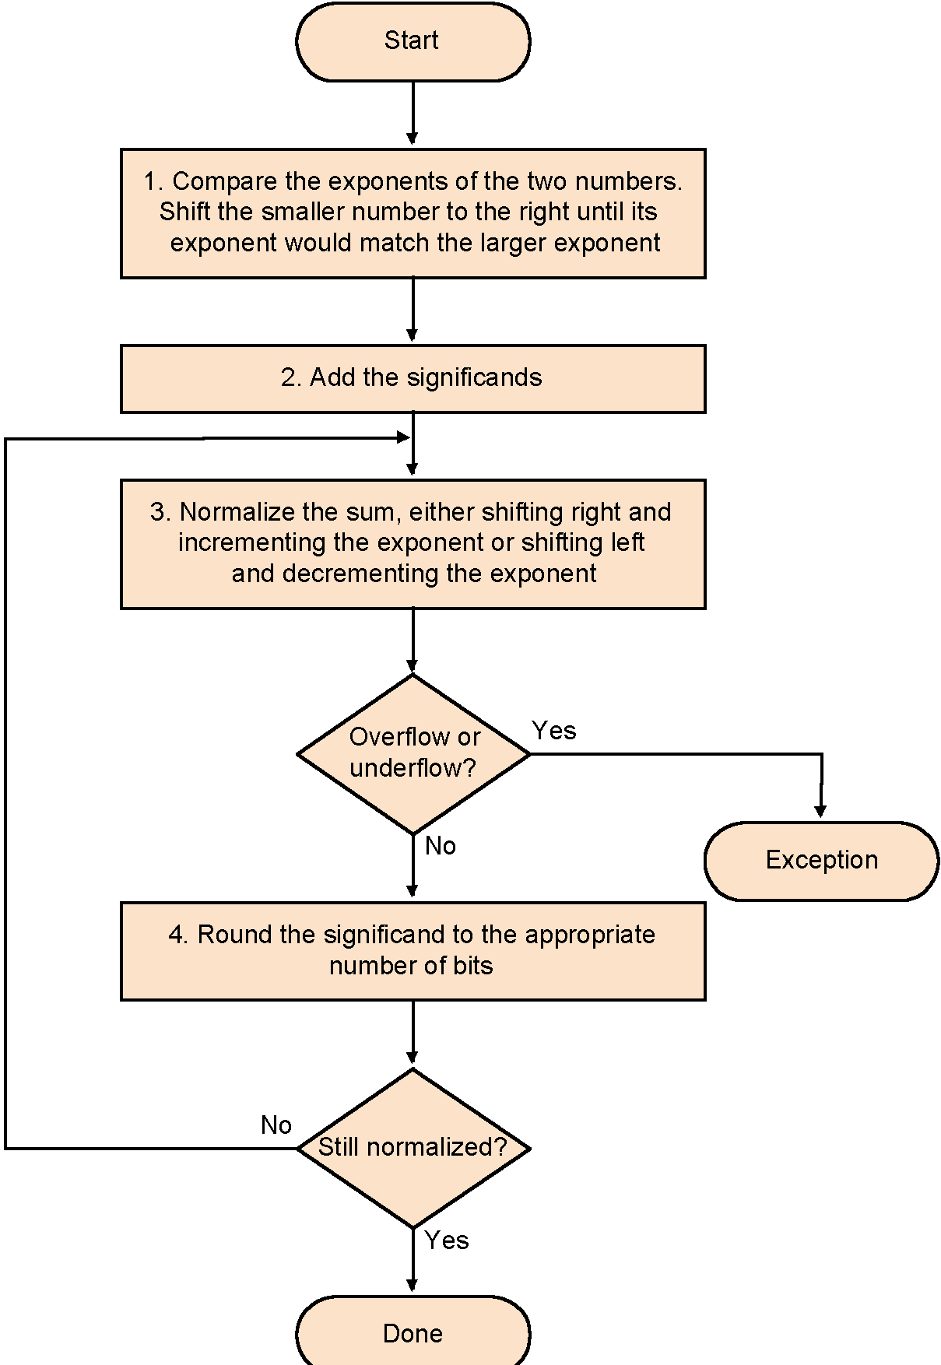
Floating-Point Addition
0
0111 1111
0000 0000 0000 0000 0000 000
0
1000 000
1000 0000 0000 0000 0000 000

Slide 65
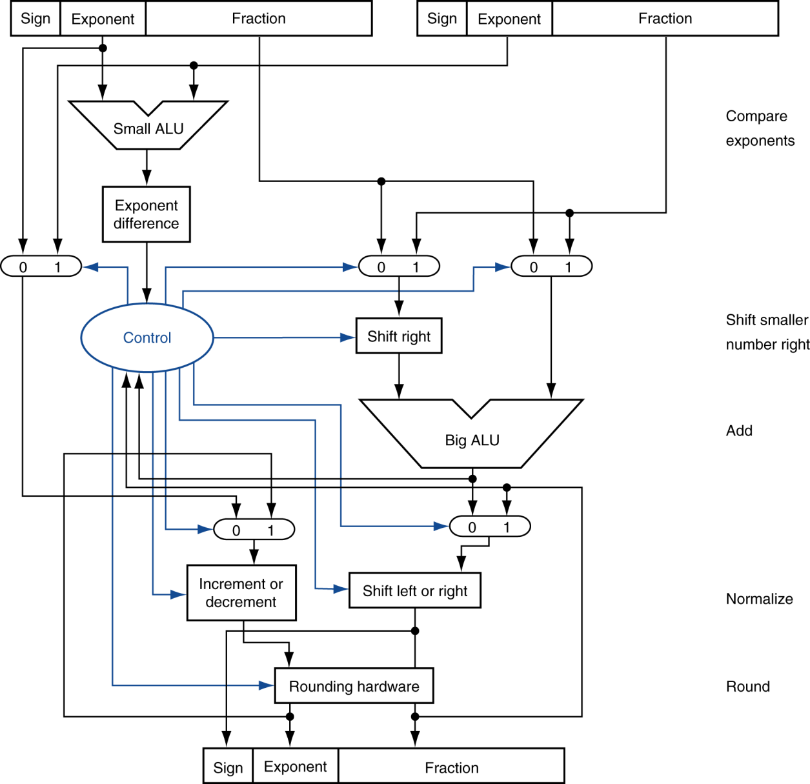
FP-Adder Hardware
Step 1
compare exponents
Step 2
equalizing exponents
Integer addition
Step 3
normalize
Step 4
round
Step 5
Result

Slide 66
Floating-Point Multiplication
Consider a 4-digit decimal example
(1.110 × 10¹⁰ ) × (9.200 × 10^{–5} )
1. Add exponents
For biased exponents, subtract bias from sum
New exponent = 10 + –5 = 5
2. Multiply significands
1.110 × 9.200 = 10.212 ⇒ 10.212 × 10⁵
3. Normalize result & check for over/underflow
1.0212 × 10⁶ (Increment the exponent if needed)
4. Round and renormalize if necessary
1.021 × 10⁶
5. Determine sign of result from signs of operands
+1.021 × 10⁶

Slide 67
Floating-Point Multiplication
Now consider a 4-digit binary example
1.000₂ × 2^{–1} × –1.110₂ × 2^{–2} (0.5 × –0.4375)
1. Add exponents
Unbiased: –1 + –2 = –3
Biased: (–1 + 127) + (–2 + 127) = –3 + 254 – 127 = –3 + 127
2. Multiply significands
1.000₂ × 1.110₂ ⇒ 1.110₂ × 2^{–3}
3. Normalize result & check for over/underflow
1.110₂ × 2^{–3} (no change) with no over/underflow
4. Round and renormalize if necessary
1.110₂ × 2^{–3} (no change)
5. Determine sign: +ve × –ve ⇒ –ve
–1.110₂ × 2^{–3} = –0.21875

Slide 68
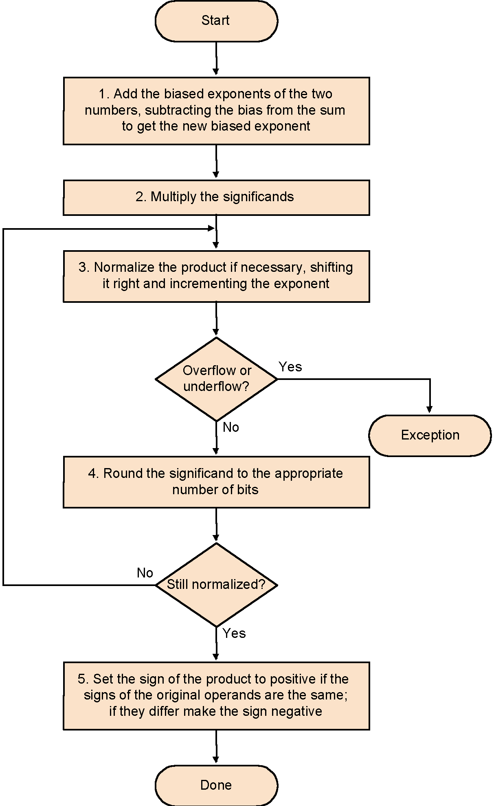
Floating-Point Multiplication

Slide 69
Integer-Multiplication Hardware
Initially 0

Slide 70
Optimized Integer Multiplier
Perform steps in parallel: add/shift
One cycle per partial-product addition
That’s ok, if frequency of multiplications is low

Slide 71
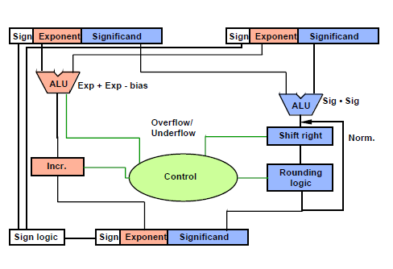
FP Multiplier – Hardware Realization
integer multiplier

Slide 72
FP Arithmetic: Hardware
FP multiplier is of similar complexity to FP adder
But uses a multiplier for significands instead of an adder
FP arithmetic hardware usually does
Addition, subtraction, multiplication, division, reciprocal, square-root
FP ↔ integer conversion
Operations usually takes several cycles
Can be pipelined

Slide 73
FP Instructions in MIPS
FP hardware is Co-processor 1
Adjunct processor that extends the ISA
Separate FP registers
32 single-precision: $f0, $f1, … $f31
Paired for double-precision: $f0/$f1, $f2/$f3, …
Release 2 of MIPs ISA supports 32 × 64-bit FP reg’s
FP instructions operate only on FP registers
Programs generally don’t do integer ops on FP data, or vice versa
More registers with minimal code-size impact
FP load and store instructions
lwc1, swc1,
e.g., lwc1 $f8, 32($sp)

Slide 74
FP Instructions in MIPS
Single-precision arithmetic
add.s, sub.s, mul.s, div.s
e.g., add.s $f0, $f1, $f6
Double-precision arithmetic
add.d, sub.d, mul.d, div.d
e.g., mul.d $f4, $f4, $f6
Single- and double-precision comparison
Branch on FP condition code true or false

Slide 75
FP Example: °F to °C
C code:
float f2c (float fahr) { return ((5.0/9.0)*(fahr - 32.0)); }
fahr in $f12, result in $f0, literals in global memory space
Compiled MIPS code:
f2c: lwc1 $f16, const5($gp) lwc2 $f18, const9($gp) div.s $f16, $f16, $f18 lwc1 $f18, const32($gp) sub.s $f18, $f12, $f18 mul.s $f0, $f16, $f18 jr $ra

Slide 76
Summary
Computer arithmetic is constrained by limited precision
Bit patterns have no inherent meaning but standards do exist
two’s complement
IEEE 754 floating point
Computer instructions determine “meaning” of the bit patterns
Performance and accuracy are important so there are many complexities and implementation challenges in real machines

Slide 77
Announcement of Next Test
Saturday, 17 October 2020
Time: 3:30 pm – 4:45 pm
Coverage: Computer Arithmetic
(Material taught in class during Sept. 28 – Oct. 08, 2020)
Question type: Short-Answer, MCQ

